Slide 1

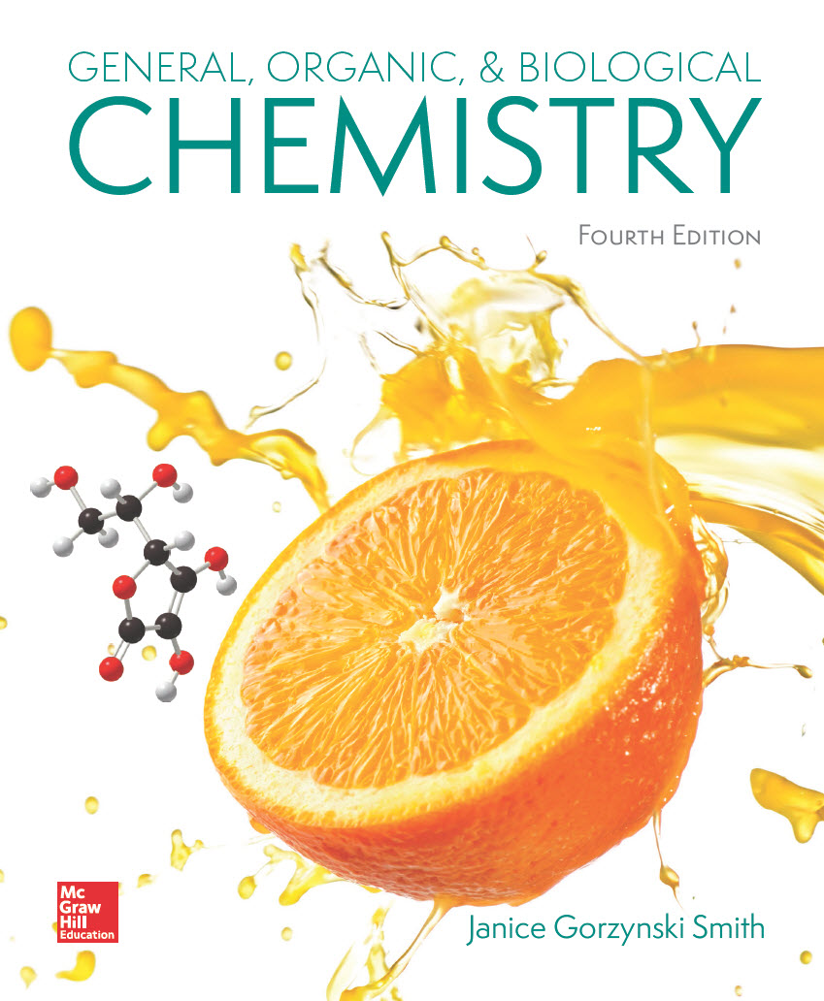
Chapter 9
Lecture
Outline
Prepared by
Harpreet Malhotra
Florida State College at Jacksonville

Slide 2
9.1 Introduction to Acids and Bases (1)
The earliest definition was given by Arrhenius:
An acid contains a hydrogen atom and dissolves in water to form a hydrogen ion,
acid
A base contains hydroxide and dissolves in water to form
base

Slide 3
9.1 Introduction to Acids and Bases (2)
The Arrhenius definition correctly predicts the behavior of many acids and bases.
However, this definition is limited and sometimes inaccurate.
For example,
does not exist in water. Instead,
it reacts with water to form the hydronium ion,
hydrogen ion:
does not really exist
in solution
hydronium ion:
actually present in
aqueous solution

Slide 4
9.1 Introduction to Acids and Bases (3)
The Brønsted–Lowry definition is more widely used:
A Brønsted–Lowry acid is a proton
donor.
A Brønsted–Lowry base is a proton
acceptor.
This proton is donated.
H₂O accepts the proton.
HCl is a Brønsted–Lowry acid.
H₂O is a Brønsted–Lowry base.

Slide 5
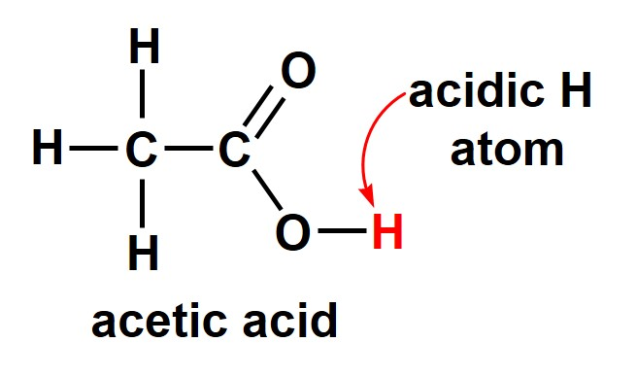
9.1 Introduction to Acids and Bases (4)
Brønsted–Lowry Acids
A Brønsted–Lowry acid must contain a hydrogen atom.
Common Brønsted–Lowry acids (HA):
HCl
hydrochloric acid
H₂SO₄
sulfuric acid
HBr
hydrobromic acid
HNO₃
nitric acid

Slide 6
9.1 Introduction to Acids and Bases (5)
Brønsted–Lowry Acids
The names of common acids are derived from the anions formed when they dissolve in water.
Anions whose names end in –ide, add the prefix hydro and change the –ide ending to –ic acid.

Slide 7
9.1 Introduction to Acids and Bases (6)
Brønsted–Lowry Acids
Polyatomic anions whose names end in –ate, change the –ate ending to –ic acid.
Polyatomic anions whose names end in –ite, change the –ite ending to –ous acid.

Slide 8
9.1 Introduction to Acids and Bases (7)
Brønsted–Lowry Acids
A monoprotic acid contains one acidic proton.
HCl
A diprotic acid contains two acidic protons.
H₂SO₄
A triprotic acid contains three acidic protons.
H₃PO₄
A Brønsted–Lowry acid may be neutral or it may carry a net positive or negative charge.
HCl,

Slide 9
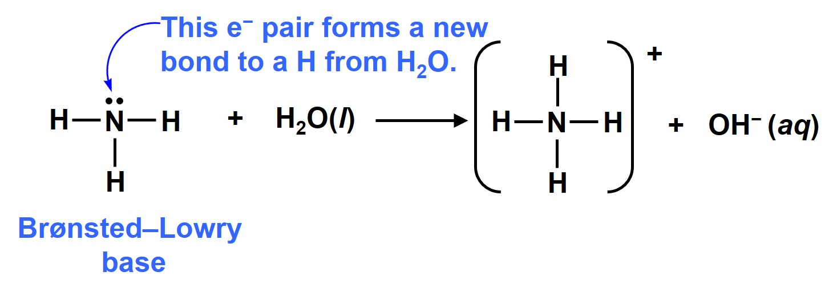
9.1 Introduction to Acids and Bases (8)
Brønsted–Lowry Bases
A Brønsted–Lowry base is a proton acceptor, so it must be able to form a bond to a proton.
A base must contain a lone pair of electrons that can be used to form a new bond to the proton.

Slide 10

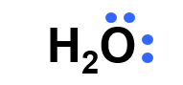
9.1 Introduction to Acids and Bases (9)
Brønsted–Lowry Bases
Common Brønsted–Lowry Bases (B:)
The
Lone pairs make these neutral compounds bases.
is the base in
each metal salt.
NaOH
sodium hydroxide
ammonia
KOH
potassium hydroxide
water
Mg(OH)₂
magnesium hydroxide
Ca(OH)₂
calcium hydroxide

Slide 11
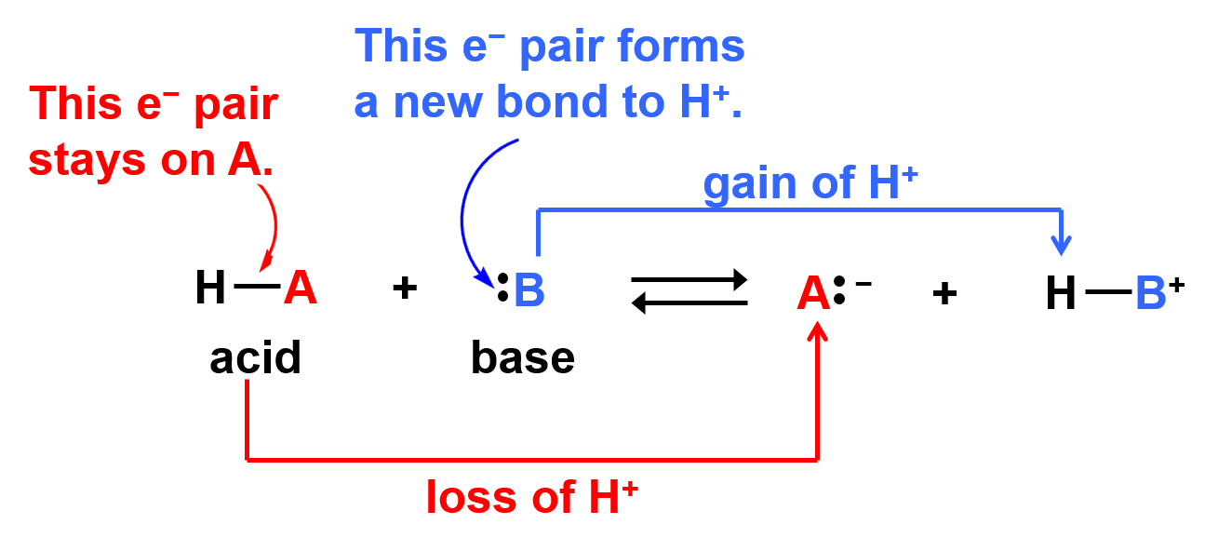
9.2 The Reaction of a Brønsted–Lowry Acid with a Brønsted–Lowry Base (1)

Slide 12
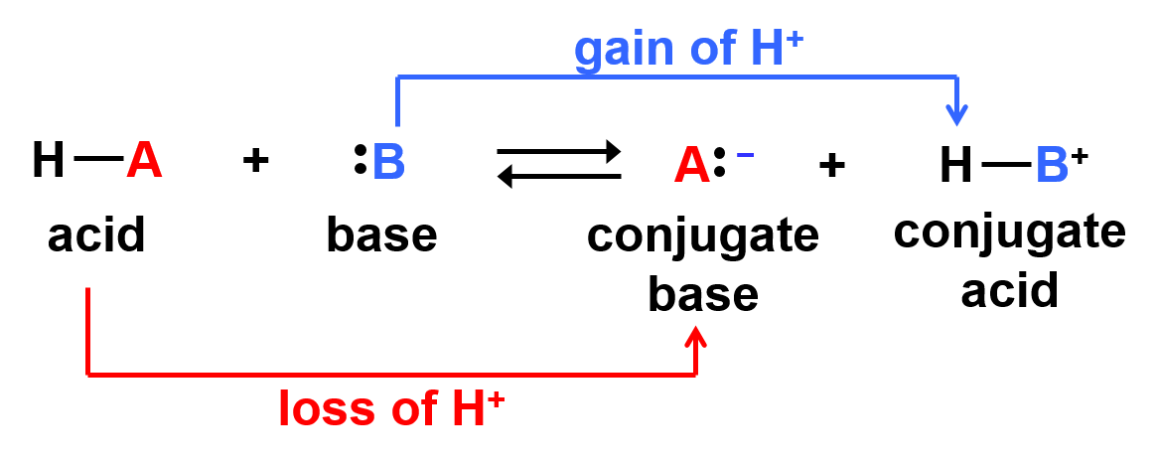
9.2 The Reaction of a Brønsted–Lowry Acid with a Brønsted–Lowry Base (2)
The product formed by loss of a proton from an acid is called its conjugate base.
The product formed by gain of a proton by a base is called its conjugate acid.

Slide 13
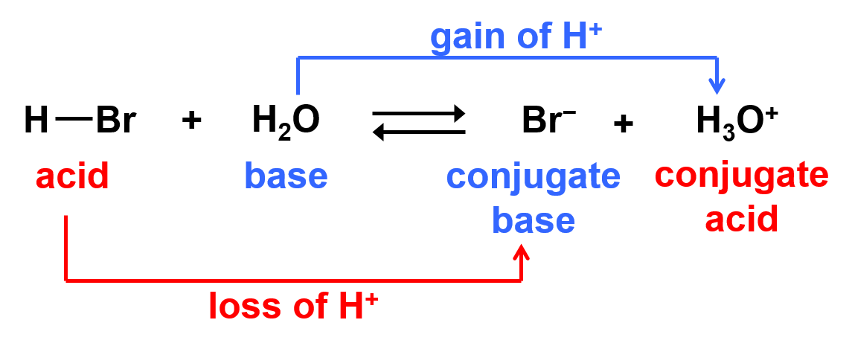
9.2 The Reaction of a Brønsted–Lowry Acid with a Brønsted–Lowry Base (3)
HBr and
are a conjugate acid–base pair.
H₂O and
are a conjugate acid–base pair.
The net charge must be the same on both sides of the equation.

Slide 14
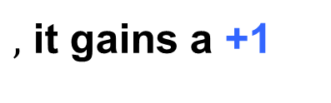
9.2 The Reaction of a Brønsted–Lowry Acid with a Brønsted–Lowry Base (4)
$,$ it gains a +1
When a species gains a proton
charge.
base
zero charge
+ 1 charge
When a species loses a proton
, it effectively
gains a −1 charge.
acid
zero charge
− 1 charge

Slide 15
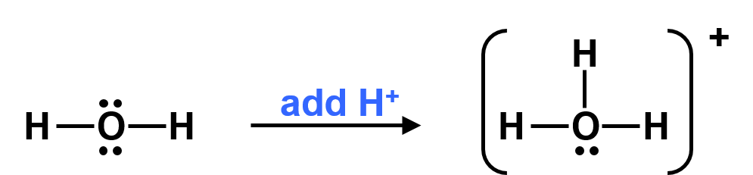
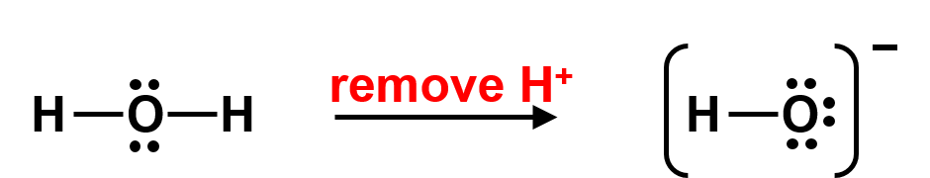
9.2 The Reaction of a Brønsted–Lowry Acid with a Brønsted–Lowry Base (5)
Amphoteric compound: A compound that contains
both a hydrogen atom and a lone pair of e⁻ ; it can
be either an acid or a base.
H₂O as a base
conjugate acid
H₂O as an acid
conjugate base

Slide 16
9.3 Acid and Base Strength (1)
Relating Acid and Base Strength
The splitting apart of a covalent molecule (or ionic compound) into its ions is called dissociation.
When a strong acid dissolves in water, 100% of the acid dissociates into ions.
A single reaction arrow is used, because the product is greatly favored at equilibrium.
Common strong acids are HI, HBr, HCl, H₂SO₄, and HNO₃.

Slide 17
9.3 Acid and Base Strength (2)
Relating Acid and Base Strength
When a weak acid dissolves in water, only a small fraction of the acid dissociates into ions.
Unequal reaction arrows are used, because the reactants are usually favored at equilibrium.
Common weak acids are H₃PO₄, HF, H₂CO₃, and HCN.

Slide 18
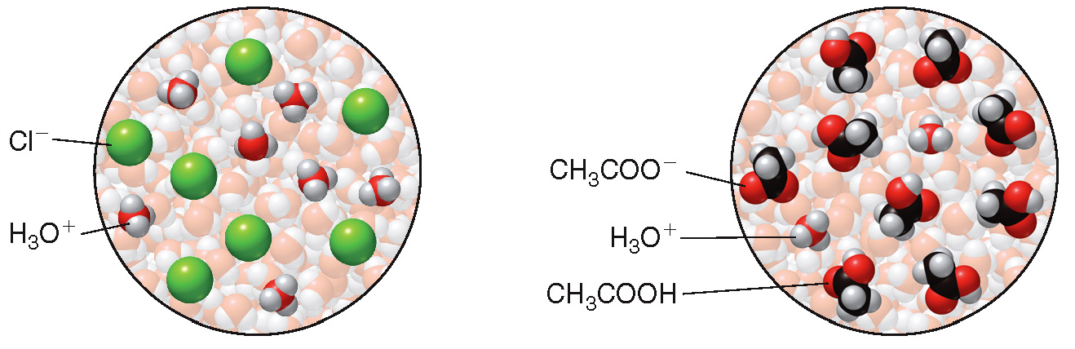
9.3 Acid and Base Strength (3)
Relating Acid and Base Strength
A strong acid, HCl, is completely dissociated
into
A weak acid, CH₃COOH,
contains mostly
undissociated acid.
and

Slide 19
9.3 Acid and Base Strength (4)
Relating Acid and Base Strength
When a strong base dissolves in water, 100% of the base dissociates into ions.
Common strong bases are NaOH and KOH.
When a weak base dissolves in water, only a small fraction of the base dissociates into ions.

Slide 20
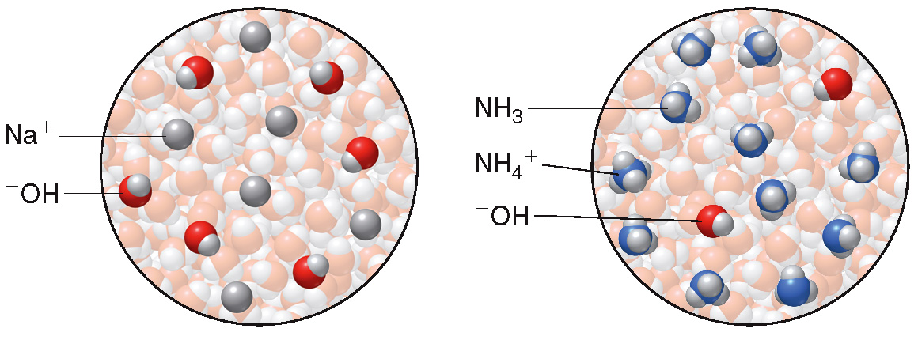
9.3 Acid and Base Strength (5)
A. Relating Acid and Base Strength
A strong base, NaOH, is completely dissociated
into
A weak base contains mostly undissociated base, NH₃.
and

Slide 21
9.3 Acid and Base Strength (6)
A. Relating Acid and Base Strength
A strong acid readily donates a proton, forming a weak conjugate base.
HCl
strong acid
weak conjugate base
A strong base readily accepts a proton, forming a weak conjugate acid.
H₂O
weak conjugate acid
strong base

Slide 22
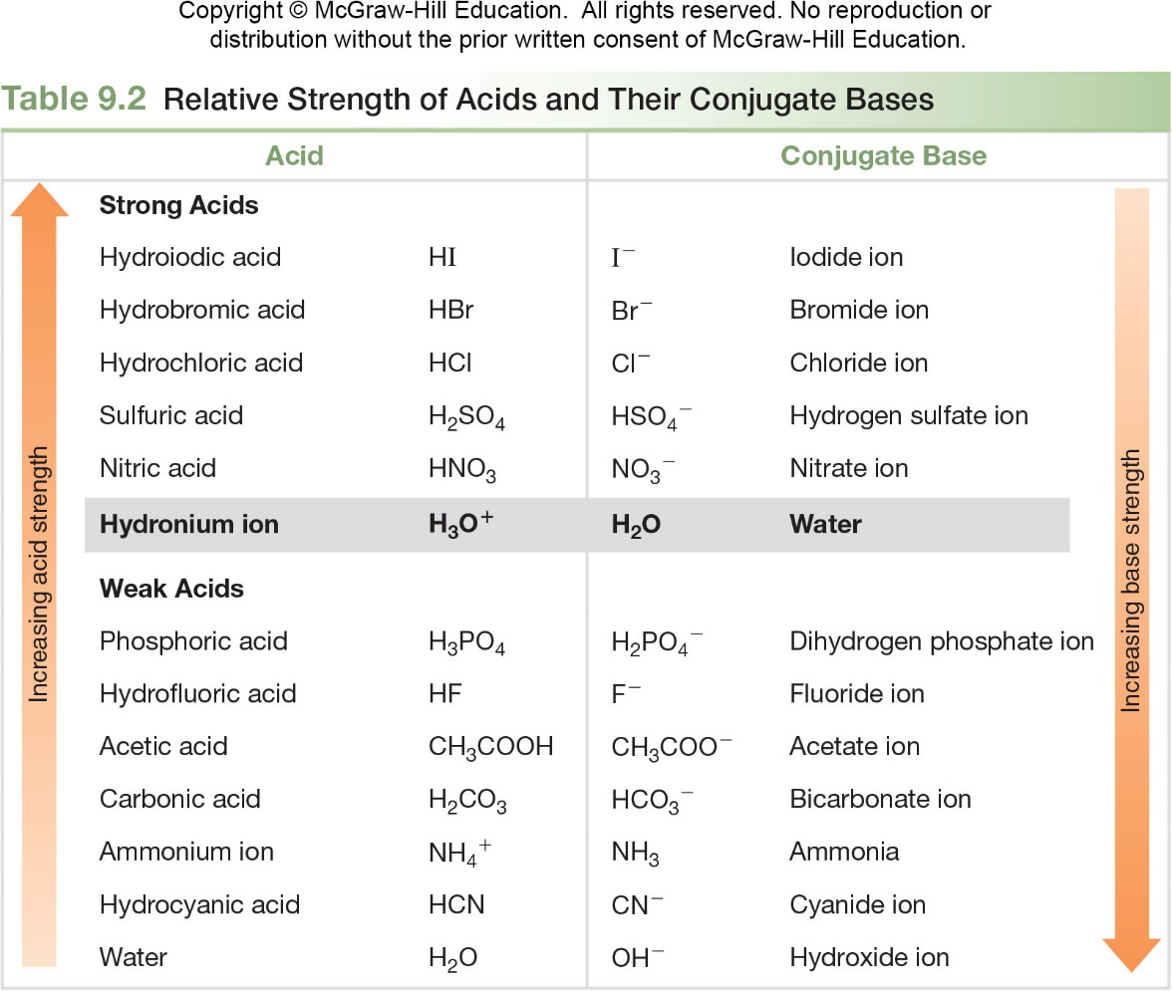
9.3 Acid and Base Strength (7)
Relating Acid and Base Strength
Table 9.2 Relative Strength of Acids and Their Conjugate Bases
Acid
Conjugate Base
Strong Acids
Hydroiodic acid
HI
Iodide ion
Hydrobromic acid
HBr
Bromide ion
Hydrochloric acid
HCl
Chloride ion
Sulfuric acid
H₂SO₄
Hydrogen sulfate ion
Nitric acid
HNO₃
Nitrate ion
Hydronium ion
H₂O
Water
Weak Acids
Phosphoric acid
H₃PO₄
Didydrogen phosphate ion
Hydrofluoric acid
HF
Fluoride ion
Acetic acid
CH₃COOH
Acetate ion
Carbonic acid
H₂CO₃
Bicarbonate ion
Ammonium ion
NH₃
Ammonia
Hydrocyanic acid
HCN
Cyanide ion
Water
H₂O
Hydroxide ion

Slide 23
9.3 Acid and Base Strength (8)
Using Acid Strength to Predict the Direction
of Equilibrium
A Brønsted–Lowry acid–base reaction represents an equilibrium.
The position of the equilibrium depends upon the strengths of the acids and bases.
The stronger acid reacts with the stronger base to form the weaker acid and the weaker base.

Slide 24
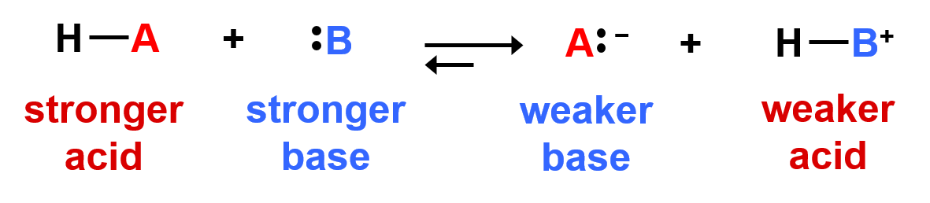
9.3 Acid and Base Strength (9)
Using Acid Strength to Predict the Direction of Equilibrium
When the stronger acid and base are the reactants on the left side, the reaction readily occurs and the reaction proceeds to the right.
A larger forward arrow means that products are favored.

Slide 25
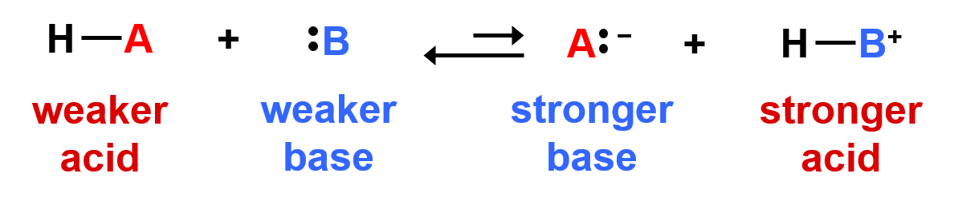
9.3 Acid and Base Strength (10)
Using Acid Strength to Predict the Direction of Equilibrium
If an acid–base reaction would form the stronger acid and base, equilibrium favors the reactants and little product forms.
A larger reverse arrow means that reactants are favored.

Slide 26
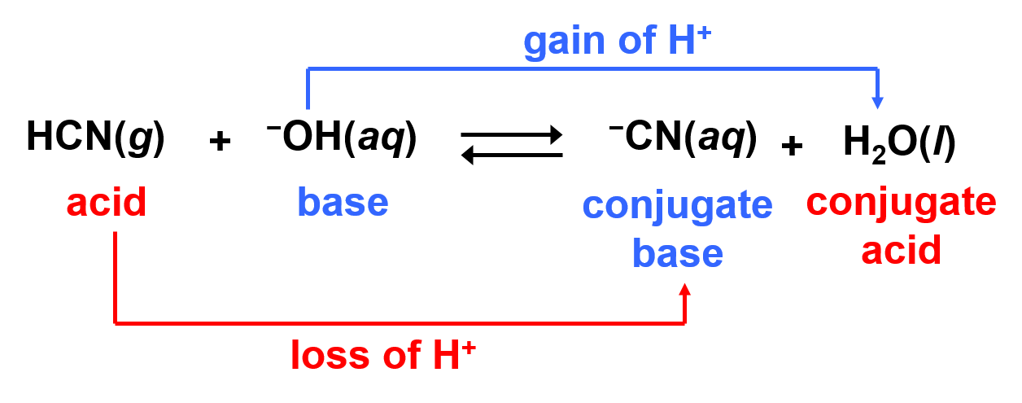
9.3 Acid and Base Strength (11)
HOW TO Predict the Direction of Equilibrium in an Acid–Base Reaction
Are the reactants or products favored in the following acid–base reaction?
Example
Identify the acid in the reactants and the conjugate acid in the products.
Step [1]

Slide 27
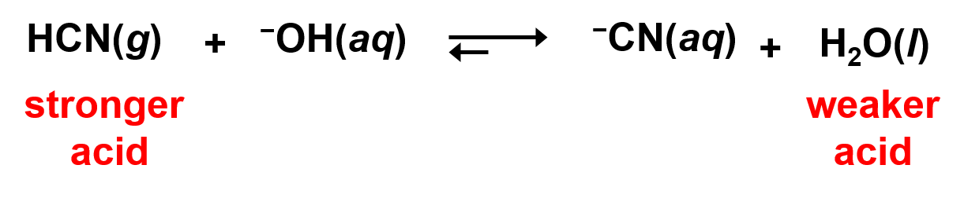
9.3 Acid and Base Strength (12)
HOW TO Predict the Direction of Equilibrium in an
Acid–Base Reaction
Step [2]
Determine the relative strength of the acid and the conjugate acid.
From Table 9.1, HCN is a stronger acid than H₂O.
Step [3]
Equilibrium favors the formation of the weaker acid.
Products are favored.

Slide 28
9.4 Equilibrium and Acid Dissociation Constants (1)
For the reaction where an acid (HA) dissolves in water,
the following equilibrium constant can be written:

Slide 29
9.4 Equilibrium and Acid Dissociation Constants (2)
Multiplying both sides by [H₂O] forms a new constant, called the acid dissociation constant,
acid dissociation constant
value.
The stronger the acid, the larger the
Equilibrium favors formation of the weaker acid, the acid with the smaller
value.

Slide 30
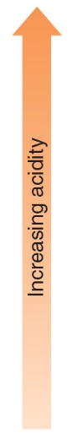
9.4 Equilibrium and Acid Dissociation Constants (3)
Table 9.3 Acid Dissociation Constants
for Common Weak Acids
Acid
Structure
Hydrogen sulfate ion
Phosphoric acid
H₃PO₄
Hydrofluoric acid
HF
Acetic acid
CH₃COOH
Carbonic acid
H₂CO₃
Dihydrogen phosphate ion
Ammonium ion
Hydrocyanic acid
HCN
Bicarbonate ion
Hydrogen phosphate ion

Slide 31
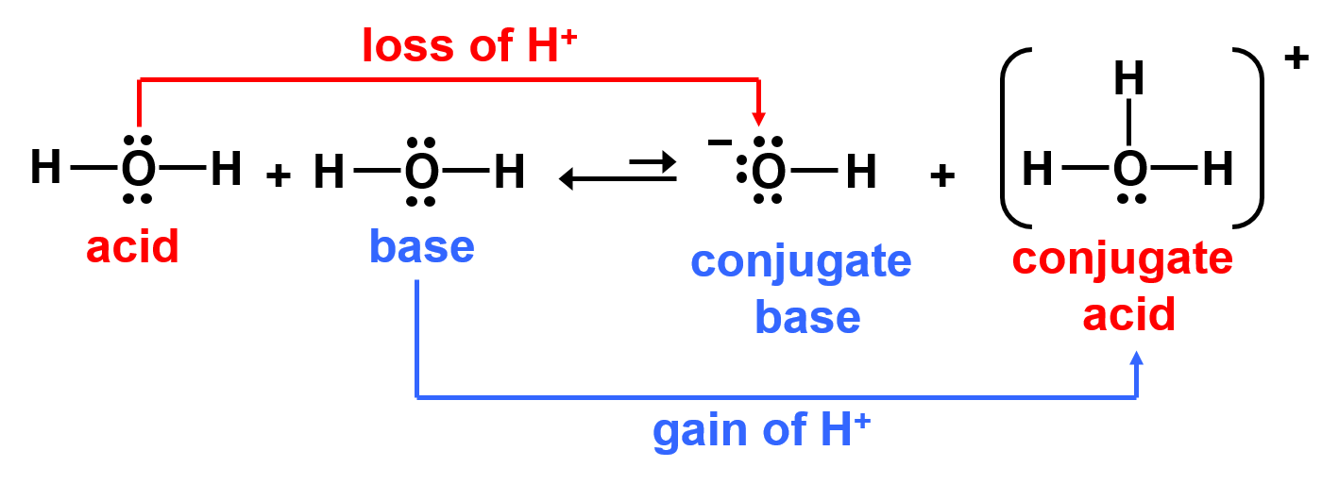
9.5 Dissociation of Water (1)
Water can behave as both a Brønsted–Lowry acid
and a Brønsted–Lowry base. Thus, two water
molecules can react together in an acid–base reaction:

Slide 32
9.5 Dissociation of Water (2)
From the reaction of two water molecules, the following equilibrium constant expression can be written:
Multiplying both sides by
, the
yields
ion-product constant for water.
ion-product constant

Slide 33

9.5 Dissociation of Water (3)
Experimentally it can be shown that:
at
is a constant,
$,$ for all aqueous
solutions at

Slide 34
9.5 Dissociation of Water (4)
To calculate
when
To calculate
when
is known:
is known:

Slide 35
9.5 Dissociation of Water (5)
If the
in a cup of coffee is
, then
the
can be calculated as follows:
In this cup of coffee, therefore,
, and
the solution is acidic overall.

Slide 36
9.5 Dissociation of Water (6)
Table 9.4 Neutral, Acidic, and Basic Solutions
Type
and
Neutral
Acidic
Basic

Slide 37
9.6 The pH Scale (1)
Calculating pH
The lower the pH, the higher the concentration of
:
Acidic solution:
Neutral solution:
Basic solution:

Slide 38
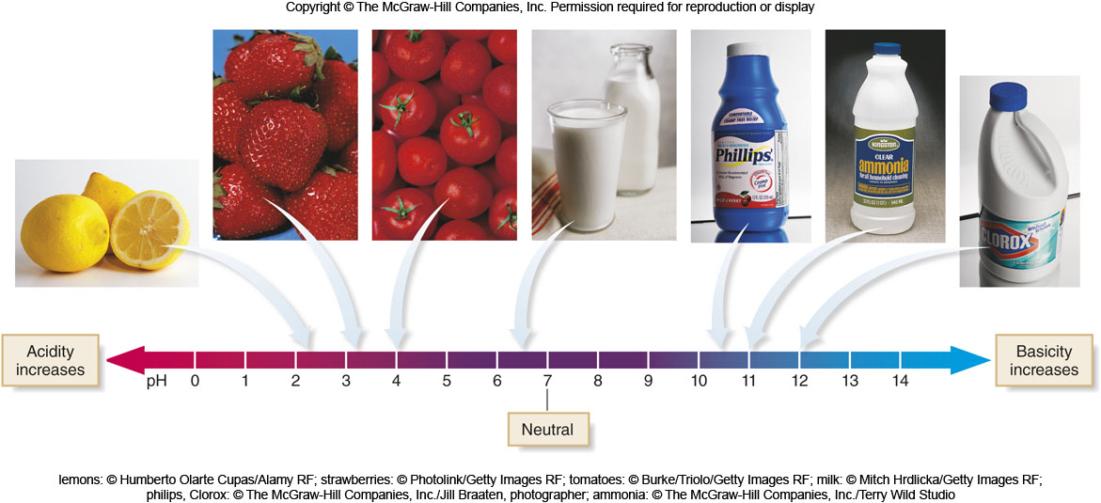
9.6 The pH Scale (2)
Calculating pH
lemons: © Humberto Olarte Cupas/Alamy RF; strawberries: © Photolink/Getty Images RF; tomatoes: © Burke/Triolo/Getty Images RF; milk: © Mitch Hrdlicka/Getty Images RF; philips, Clorox: © The McGraw-Hill Companies, Inc./Jill Braaten, photographer; ammonia: © The McGraw-Hill Companies, Inc./Terry Wild Studio

Slide 39
9.6 The pH Scale (3)
Calculating pH Using a Calculator
A logarithm has the same number of places after the decimal as there are digits in the original number.
Example:
If
for a solution, what is its pH?
2 digits
pH = − (− 4.92) 2 decimal places
pH = 4.92
The solution is acidic because the pH < 7.

Slide 40
9.6 The pH Scale (4)
Calculating pH Using a Calculator
If the pH of a solution is 8.50, what is the
2 decimal places
2 digits
The solution is basic because

Slide 41
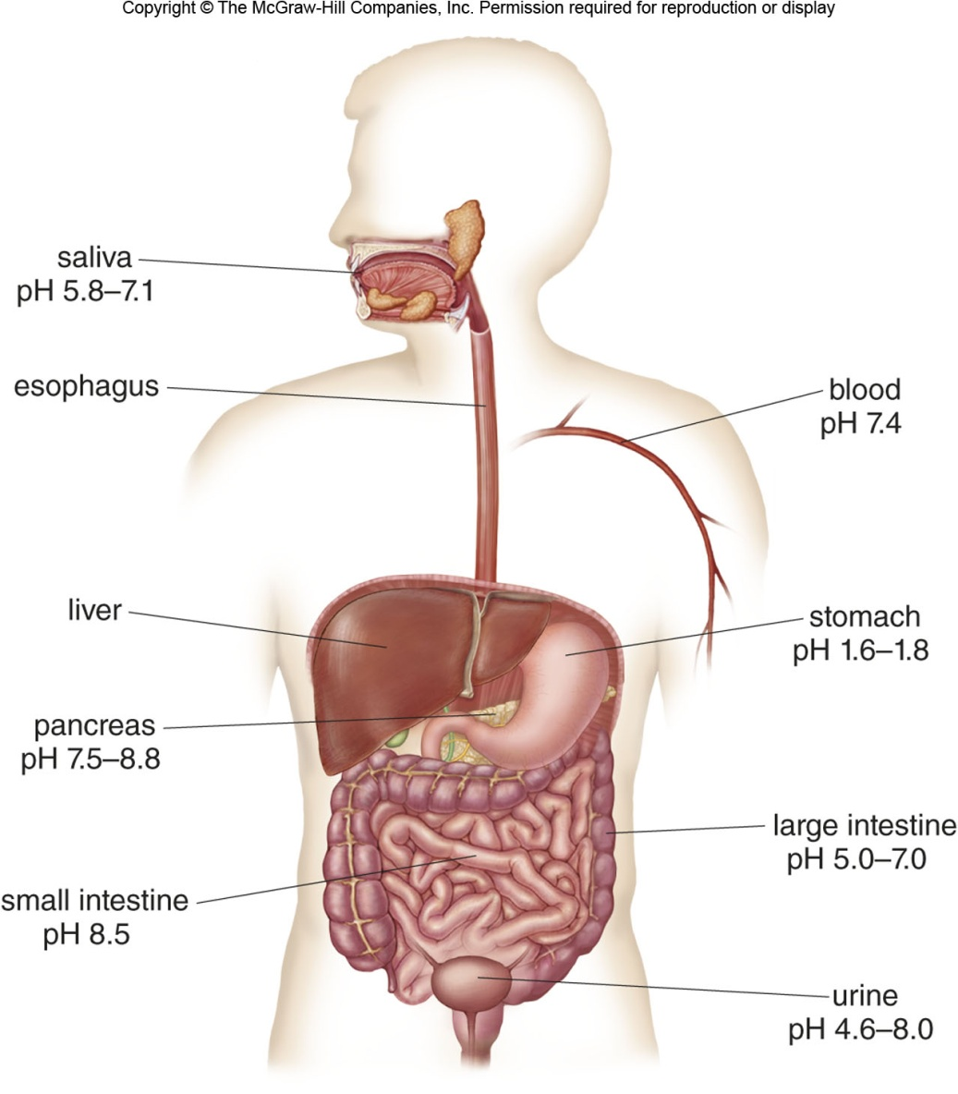
9.6 The pH Scale (5)

Slide 42
9.7 Common Acid–Base Reactions (1)
Reaction of Acids with Hydroxide Bases
Neutralization reaction: An acid-base reaction that produces a salt and water as products.
The acid HA donates a proton
to the
base
to form H₂O.
The anion
from the acid combines with the
cation
from the base to form the salt MA.

Slide 43
9.7 Common Acid–Base Reactions (2)
HOW TO Draw a Balanced Equation for a Neutralization
Reaction Between HA and MOH
Example
Write a balanced equation for the reaction of Mg(OH)₂ with HCl.
Step [1]
Identify the acid and base in the reactants and draw H₂O as one product.

Slide 44
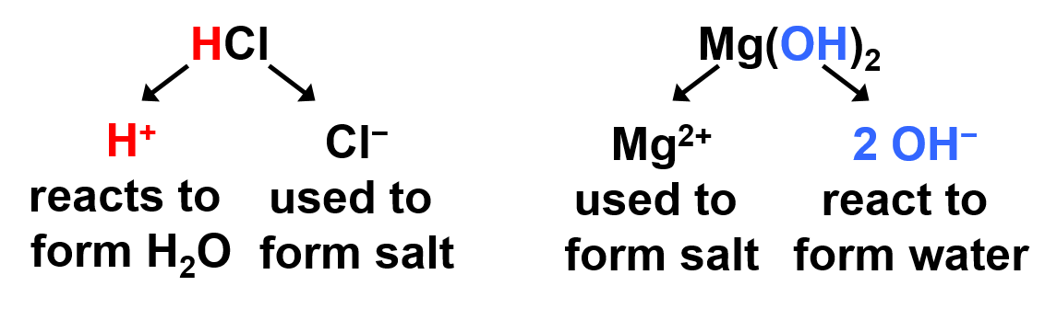
9.7 Common Acid–Base Reactions (3)
HOW TO Draw a Balanced Equation for a Neutralization
Reaction between HA and MOH
Step [2]
Determine the structure of the salt.
The salt is formed from the parts of the acid and base that are not used to form H₂O.
and
combine to form MgCl₂.

Slide 45
9.7 Common Acid–Base Reactions (4)
HOW TO Draw a Balanced Equation for a Neutralization
Reaction between HA and MOH
Step [3]
Balance the equation.
Place a 2 to
balance O and H.
Place a 2 to
balance Cl.

Slide 46
9.7 Common Acid–Base Reactions (5)
Reaction of Acids with Hydroxide Bases
A net ionic equation contains only the species involved in a reaction.
Written as individual ions:
Omit the spectator ions,
and
.
What remains is the net ionic equation:

Slide 47
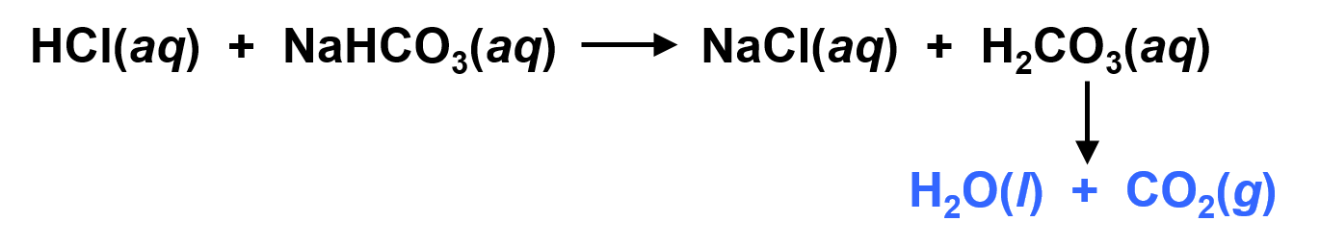
9.7 Common Acid–Base Reactions (6)
Reaction of Acids with Bicarbonate Bases
A bicarbonate base,
reacts with one
to
form carbonic acid,
.
Carbonic acid then decomposes into H₂O and CO₂.
For example:

Slide 48
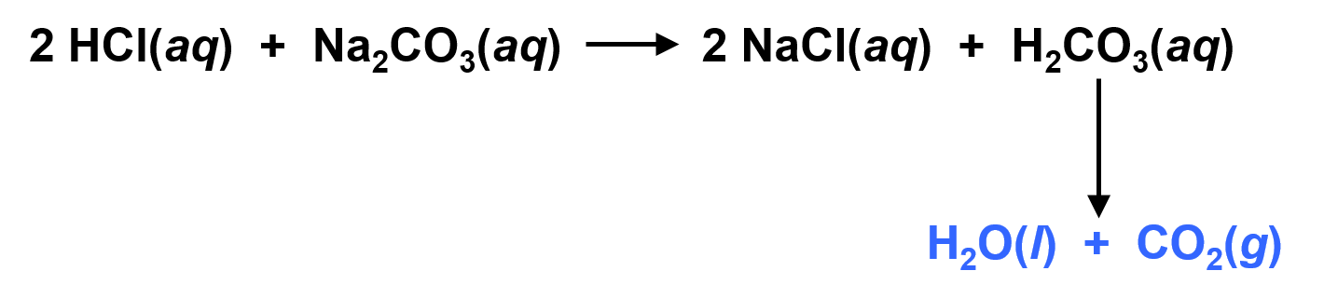
9.7 Common Acid–Base Reactions (7)
Reaction of Acids with Bicarbonate Bases
A carbonate base,
, reacts with two
to
form carbonic acid,
For example:

Slide 49
9.8 The Acidity and Basicity of Salt Solutions (1)
A salt can form an acidic, basic, or neutral
solution depending on whether its cation and anion
are derived from a strong or weak acid and base.
For the salt
:
The cation
comes from the base.
The anion
comes from the acid.

Slide 50
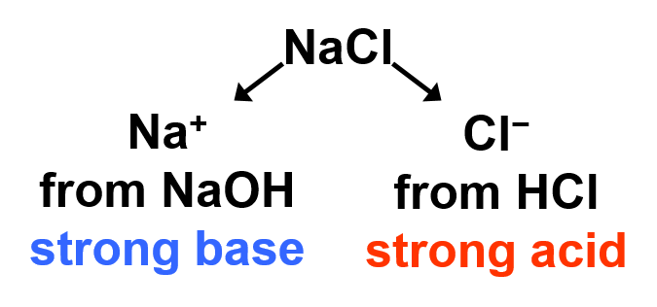
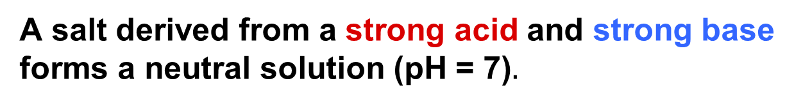
9.8 The Acidity and Basicity of Salt Solutions (2)
A salt derived from a strong acid and strong base forms a neutral solution (pH = 7)$.$

Slide 51
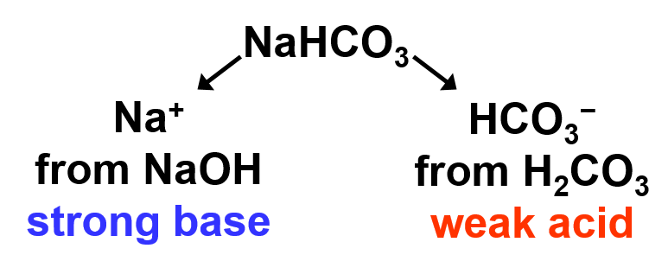
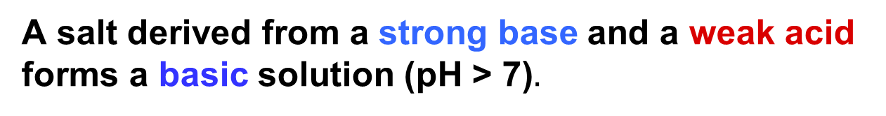
9.8 The Acidity and Basicity of Salt Solutions (3)
A salt derived from a strong base and a weak acid forms a basic solution (pH > 7)$.$

Slide 52
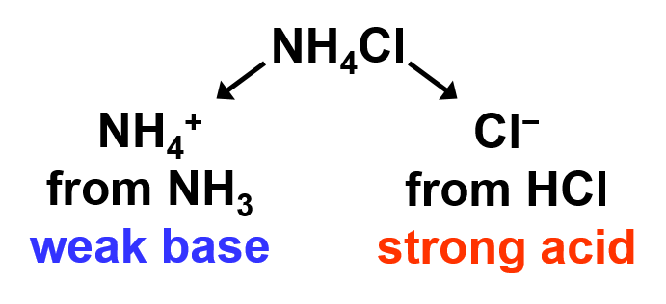
9.8 The Acidity and Basicity of Salt Solutions (4)
A salt derived from a weak base and a strong acid forms an acidic solution (pH < 7).

Slide 53
9.8 The Acidity and Basicity of Salt Solutions (5)
Table 9.5 The Acidity and Basicity of Salt Solutions
Cation Derived from | Anion Derived from | Solution | pH | Examples
Strong base | Strong acid | Neutral | 7 | NaCl, KBr, NaNO₃
Strong base | Weak acid | Basic | > 7 | NaHCO₃, KCN, CaF₂
Weak base | Strong acid | Acidic | < 7 | NH₄Cl, NH₄NO₃
Thus, the ion derived from the stronger acid or base determines whether the solution is acidic or basic.

Slide 54
9.9 Titration (1)
To determine the concentration of an acid or base in a solution, we carry out a titration.
If we want to know the concentration of an acid solution, a base of known concentration is added slowly until the acid is neutralized.
When the acid is neutralized.
# of moles of acid = # of moles of base
This is called the end point of the titration.

Slide 55
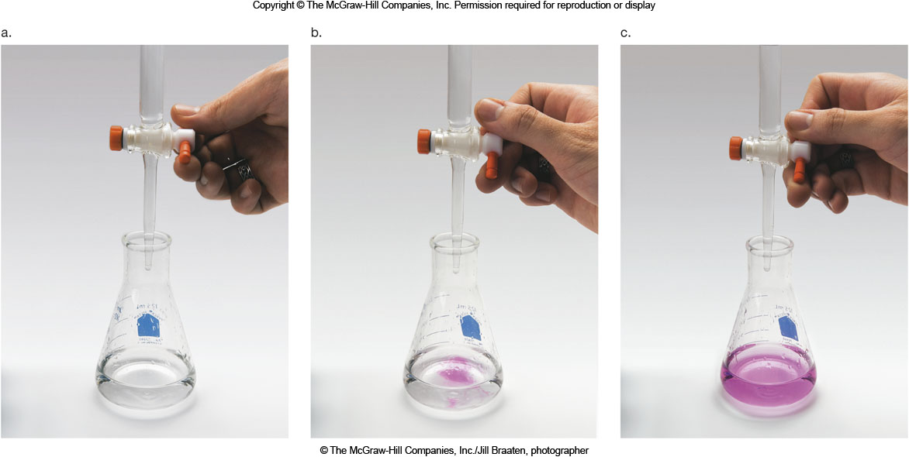
9.9 Titration (2)
© The McGraw-Hill Companies, Inc./Jill Braaten, photographer

Slide 56
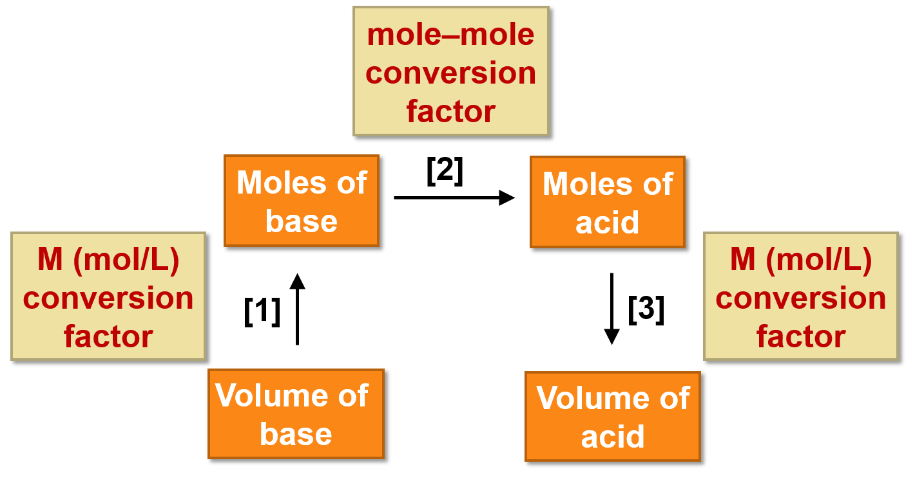
9.9 Titration (3)
Determining an unknown molarity from titration data
requires three operations:

Slide 57
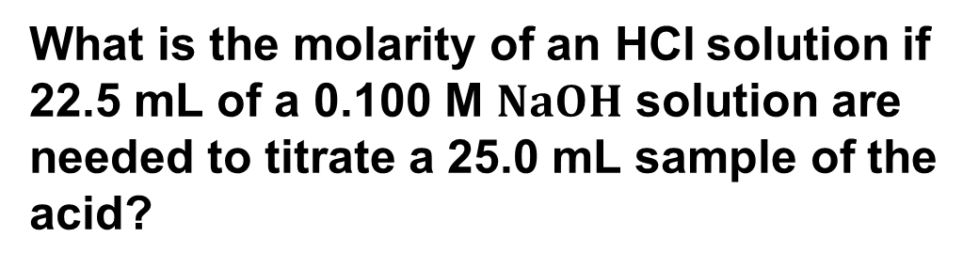
9.9 Titration (4)
HOW TO Determine the Molarity of an Acid Solution
from Titration
Example
What is the molarity of an HCl solution if 22.5 mL of a 0.100 M $NaOH$ solution are needed to titrate a 25.0 mL sample of the acid?
volume of base (NaOH)
22.5 mL
volume of acid (HCL)
25.0 mL
conc. of base (NaOH)
0.100 M
conc. of acid (HCL)
?

Slide 58
9.9 Titration (5)
HOW TO Determine the Molarity of an Acid Solution from Titration
Step [1]
Determine the number of moles of base used to neutralize the acid.
M (mol/L) conversion factor
Volume of base
22.5 mL NaOH
= 0.00225 mol NaOH
Moles of base

Slide 59
9.9 Titration (6)
HOW TO Determine the Molarity of an Acid Solution
from Titration
Step [2]
Determine the number of moles of acid that react from the balanced chemical equation.
mole–mole conversion factor
Moles of base
Moles of acid

Slide 60
9.9 Titration (7)
HOW TO Determine the Molarity of an Acid Solution
from Titration
Step [3]
Determine the molarity of the acid from the number of moles and the known volume.
3 sig. fig. Answer
mL—L conversionfactor

Slide 61
9.10 Buffers (1)
A buffer is a solution whose pH changes very little
when acid or base is added.
Most buffers are solutions composed of roughly equal amounts of:
A weak acid
The salt of its conjugate base
The buffer resists change in pH because
Added base,
, reacts with the weak acid
Added acid,
, reacts with the conjugate base

Slide 62
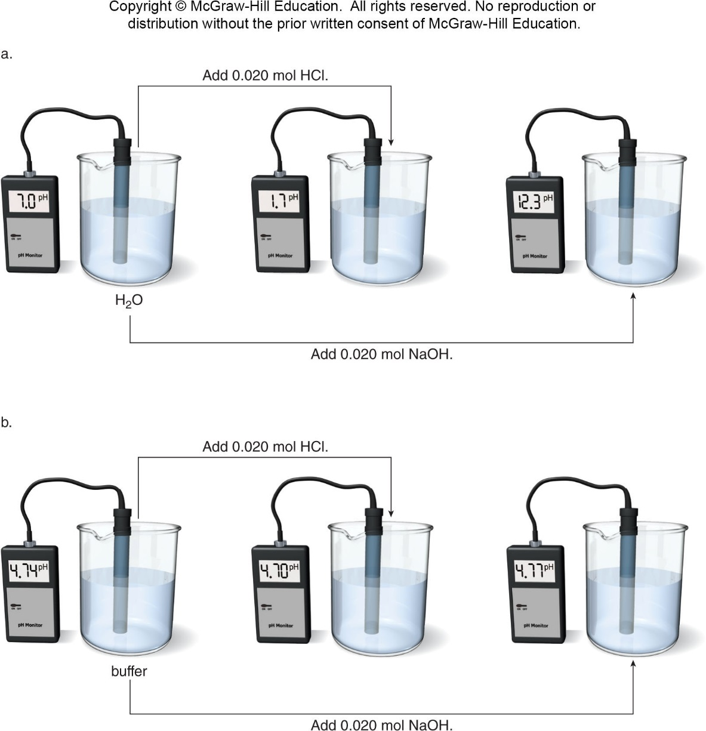
9.10 Buffers (2)

Slide 63
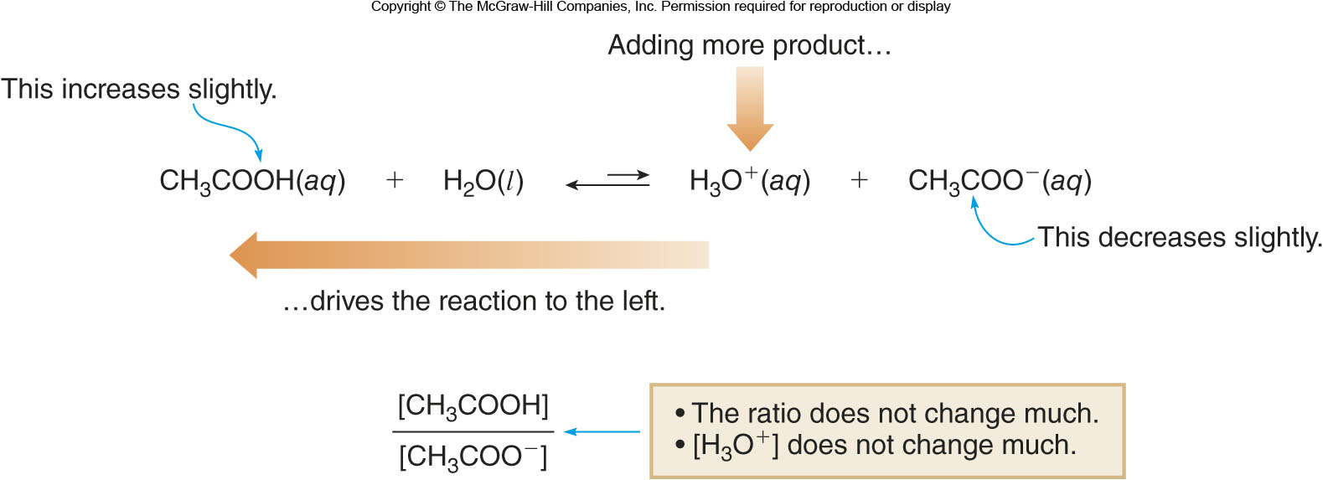
9.10 Buffers (3)
General Characteristics of a Buffer
If an acid is added to the following buffer equilibrium,
then the excess acid reacts with the conjugate base, so the overall pH does not change much.

Slide 64
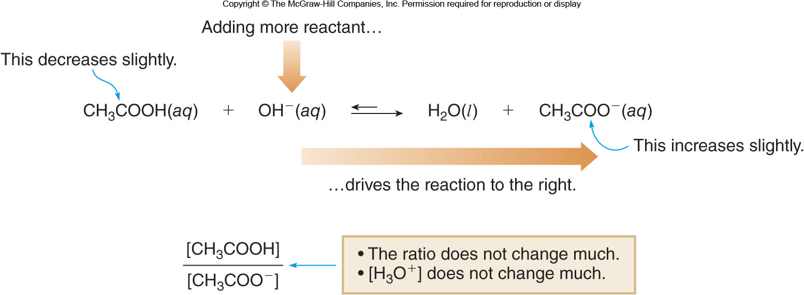
9.10 Buffers (4)
General Characteristics of a Buffer
If a base is added to the following buffer equilibrium,
then the excess base reacts with the conjugate acid,
so the overall pH does not change much.

Slide 65
9.10 Buffers (5)
Table 9.6 Common Buffers
Buffer
Weak Acid
Conjugate Base
Acetic acid/acetate
CH₃COOH
Bicarbonate/carbonate
Dihydrogen phosphate/ hydrogen phosphate
Hydrogen phosphate/ phosphate

Slide 66
9.10 Buffers (6)
Calculating the pH of a Buffer
The effective pH range of a buffer depends on its
:
Rearranging this expression to solve for
Hydronium ion concentration determines the buffer pH

Slide 67
9.11 Focus on the Human Body
Buffers in the Blood (1)
Normal blood pH is between 7.35 and 7.45.
The principle buffer in the blood is carbonic acid/ bicarbonate
CO₂ is constantly produced by metabolic processes in the body.
The amount of CO₂ is related to the pH of the blood.

Slide 68
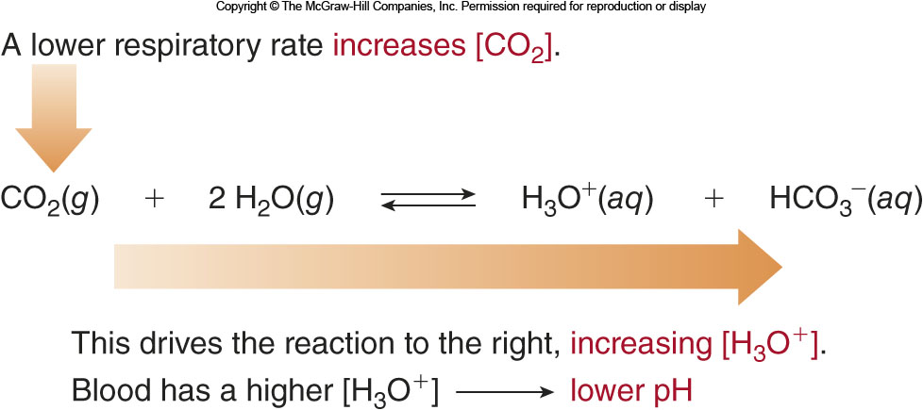
9.11 Focus on the Human Body
Buffers in the Blood (2)
Respiratory acidosis results when the body fails to
eliminate enough CO₂, due to lung disease or failure.

Slide 69
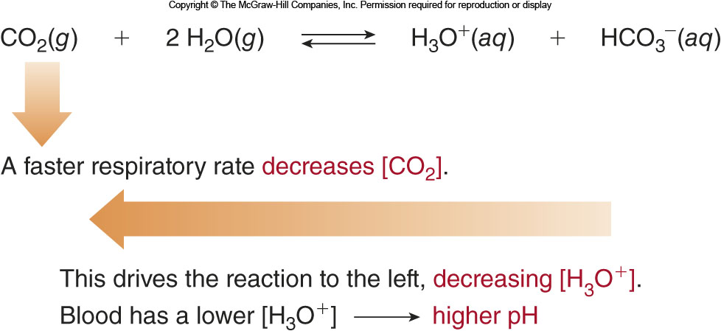
9.11 Focus on the Human Body
Buffers in the Blood (3)
Respiratory alkalosis is caused by hyperventilating;
very little CO₂ is produced by the body.

